Slide 1

Machine Learning Basics for Plasma Physics Regression and Inference
Dr Aidan Crilly
Eric and Wendy Schmidt AI in Science Postdoctoral Fellow
Member of Plasma Group within the Community of Natural Environment

Slide 2
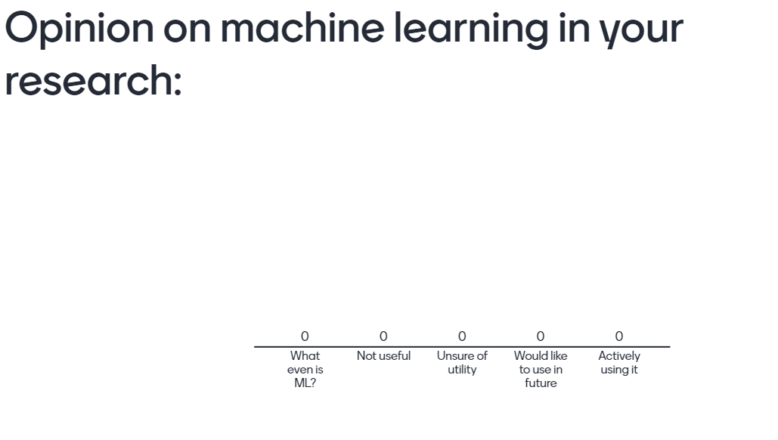
Go to menti.com and enter code 12 81 80 5

Slide 3
What to expect?
This talk aims to:
Introduce key machine learning (ML) concepts and language
Relate ML techniques to more familiar numerical methods
Introduce ML techniques which have been used in Plasma Group’s research
Hopefully, be a jumping off point to learning more about ML useful to your own research
This talk does not aim to:
Discuss ML research, we will discuss ML in research
Be an authority on ML, it would be great if this could become a discussion on use cases

Slide 4
Overview
What is Machine Learning?
Regression & Classification
Parametric Regressors (Non-neural)
Ordinary and Non-Linear Least Squares
Bayesian Inference
Non-Parametric Regressors
Gaussian Processes
Neural Networks

Slide 5
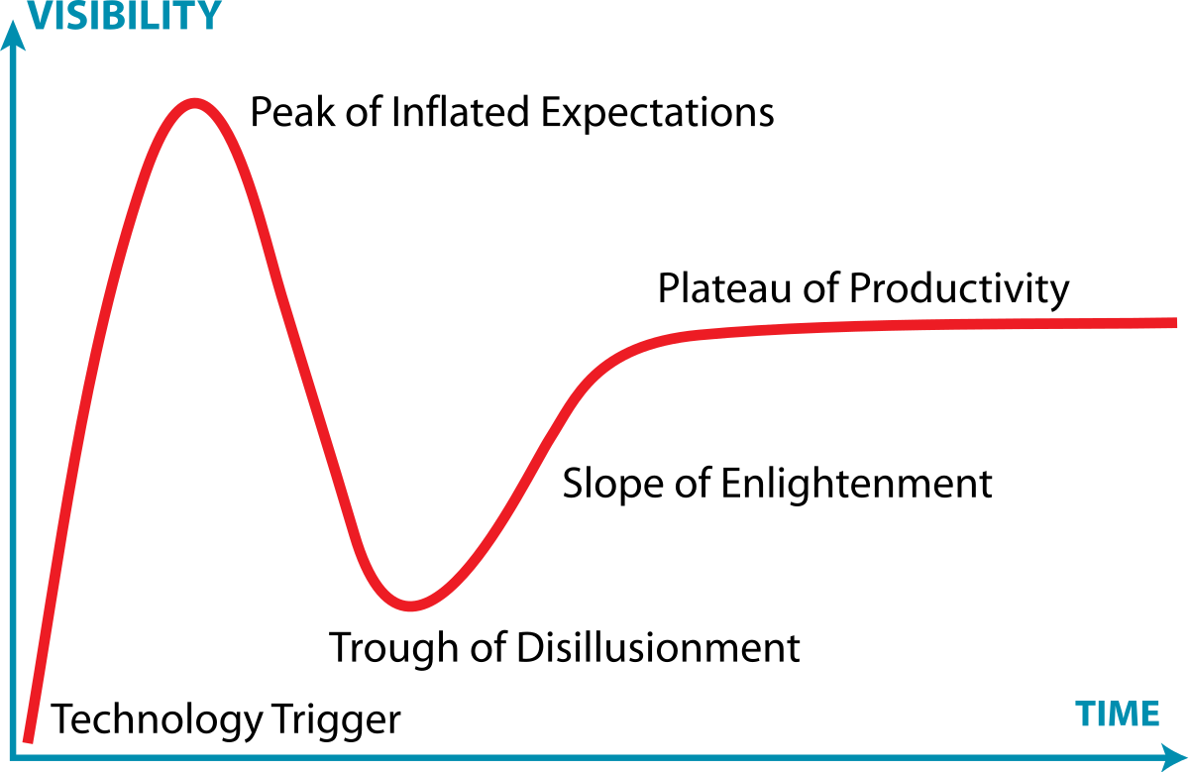
What is “Machine Learning”?
Numerical modelling which adapts parameters algorithmically to learn the relationship between input and output data
Parameter evolution often posed as an optimisation problem (nothing new!)
User often must select ‘hyper-parameters’ which change aspects of the machine learning algorithm

Slide 6

Regression & Classification
Two of the core ML tasks are regression and classification
Classification is the task of placing data within a finite number of sets, for example determining if a photo contains a cat or not
Regression is the task of estimating the functional relationship between a set of input and output variables, for example fitting a straight line to (x,y) data pairs

Slide 7
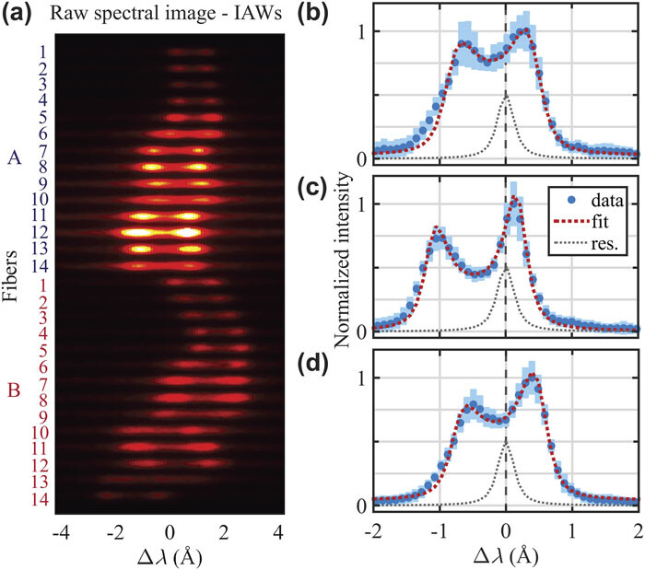
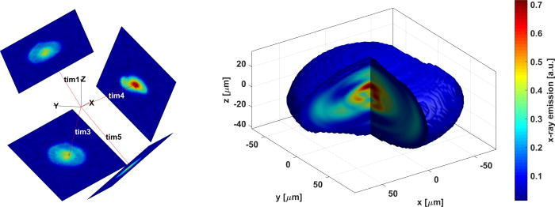
Regression
Regression problems are ubiquitous in data analysis within the physical sciences
An entirely non-exhaustive list of examples from my research:
Image reconstruction and 3D tomography
Thomson scattering spectra
Fusion neutron spectroscopy
X-ray line spectroscopy
Typically, reduced models with small number of parameters are used to fit each diagnostic signal separately
Latent parameters of numerical models can also be learned via regression

Slide 8
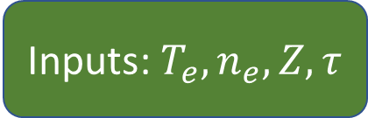
Parametric Regressors
The most common form of regression includes a ‘physics-based’ model which maps input physical parameters (e.g. temperature and density) to the expected diagnostic signature
For example, line spectroscopy
The ‘optimal’ set of parameters which match the observed data are sought in a forward-fit process
Inputs: $T_{e},n_{e},Z,τ$
Atomic Physics Model
Data-model consistency

Slide 9
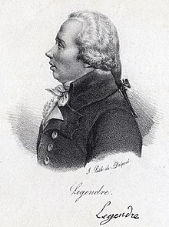
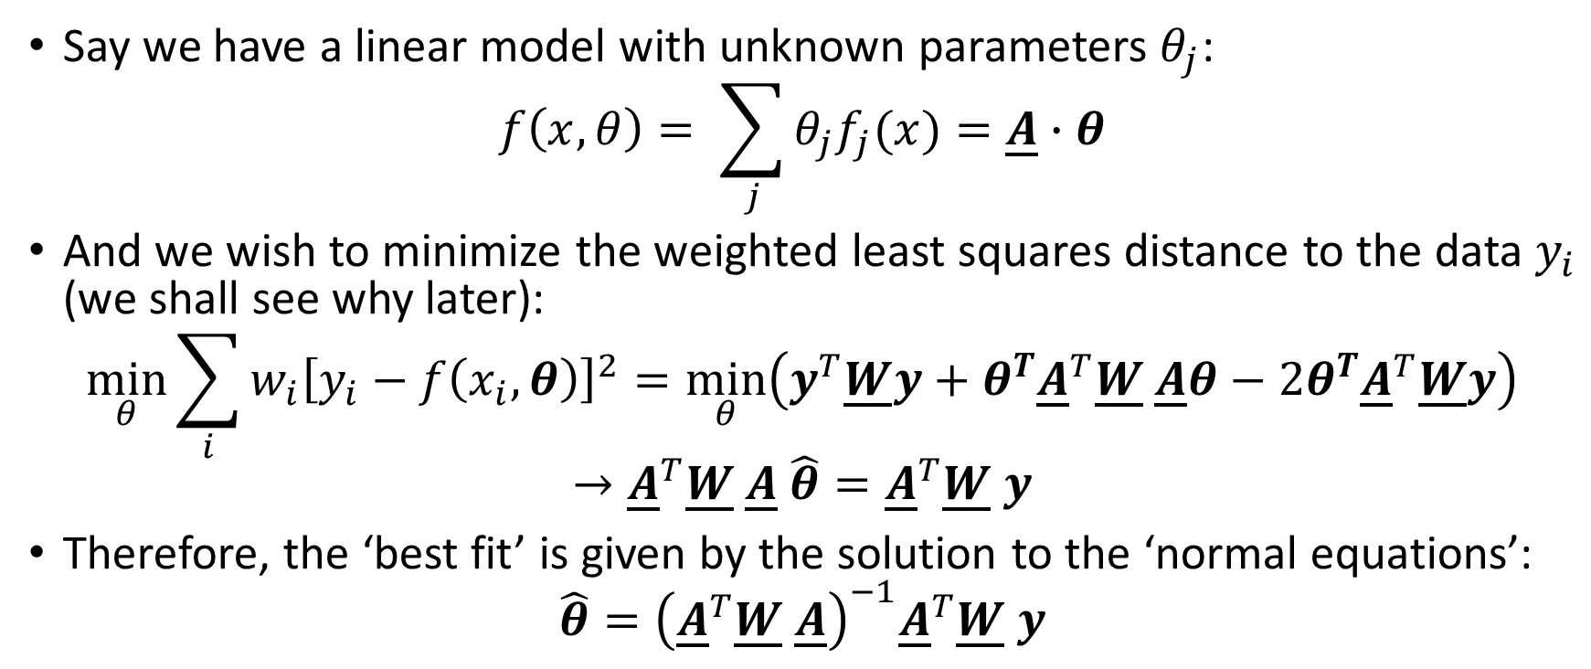
Ordinary Least Squares
Say we have a linear model with unknown parameters $θ_{j}$:
$$f\left(x,θ\right)= \sum_{j}{θ_{j}f_{j}(x)}=\underline{A}∙θ$$
And we wish to minimize the weighted least squares distance to the data $y_{i}$ (we shall see why later):
$$\min_{θ}{\sum_{i}{{w_{i}\left[y_{i}−f\left(x_{i},θ\right)\right]}^{2}}}=\min_{θ}\left(y^{T}\underline{W}y+θ^{T}{\underline{A}}^{T}\underline{W} \underline{A}θ−2θ^{T}{\underline{A}}^{T}\underline{W}y\right)$$
$$→{\underline{A}}^{T}\underline{W} \underline{A} \hat{θ}={\underline{A}}^{T}\underline{W} y$$
Therefore, the ‘best fit’ is given by the solution to the ‘normal equations’:
$$\hat{θ}={\left({\underline{A}}^{T}\underline{W} \underline{A}\right)}^{−1}{\underline{A}}^{T}\underline{W} y$$

Slide 10
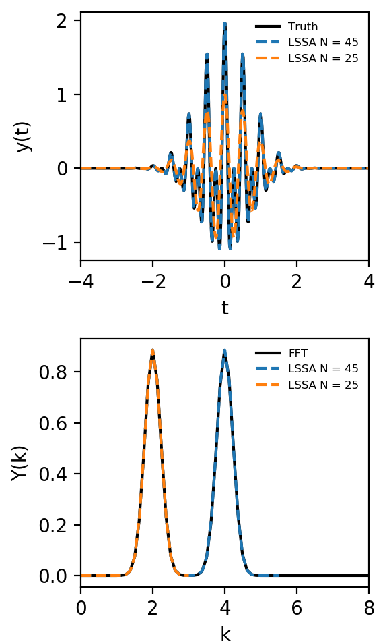

Practical example
Least-squares spectral analysis (LSSA) is a linear regression problem
Can handle unequally spaced data, uncertainties and limit the mode number
See Lomb-Scargle method
Not formally a Discrete Fourier Transform
$$f\left(x,θ\right)= \sum_{j=0}^{N}{θ_{j}\cos\left[\frac{πj}{T}t\right]}=\underline{A}∙θ$$
$$\hat{θ}={\left({\underline{A}}^{T} \underline{A}\right)}^{−1}{\underline{A}}^{T}y$$

Slide 11
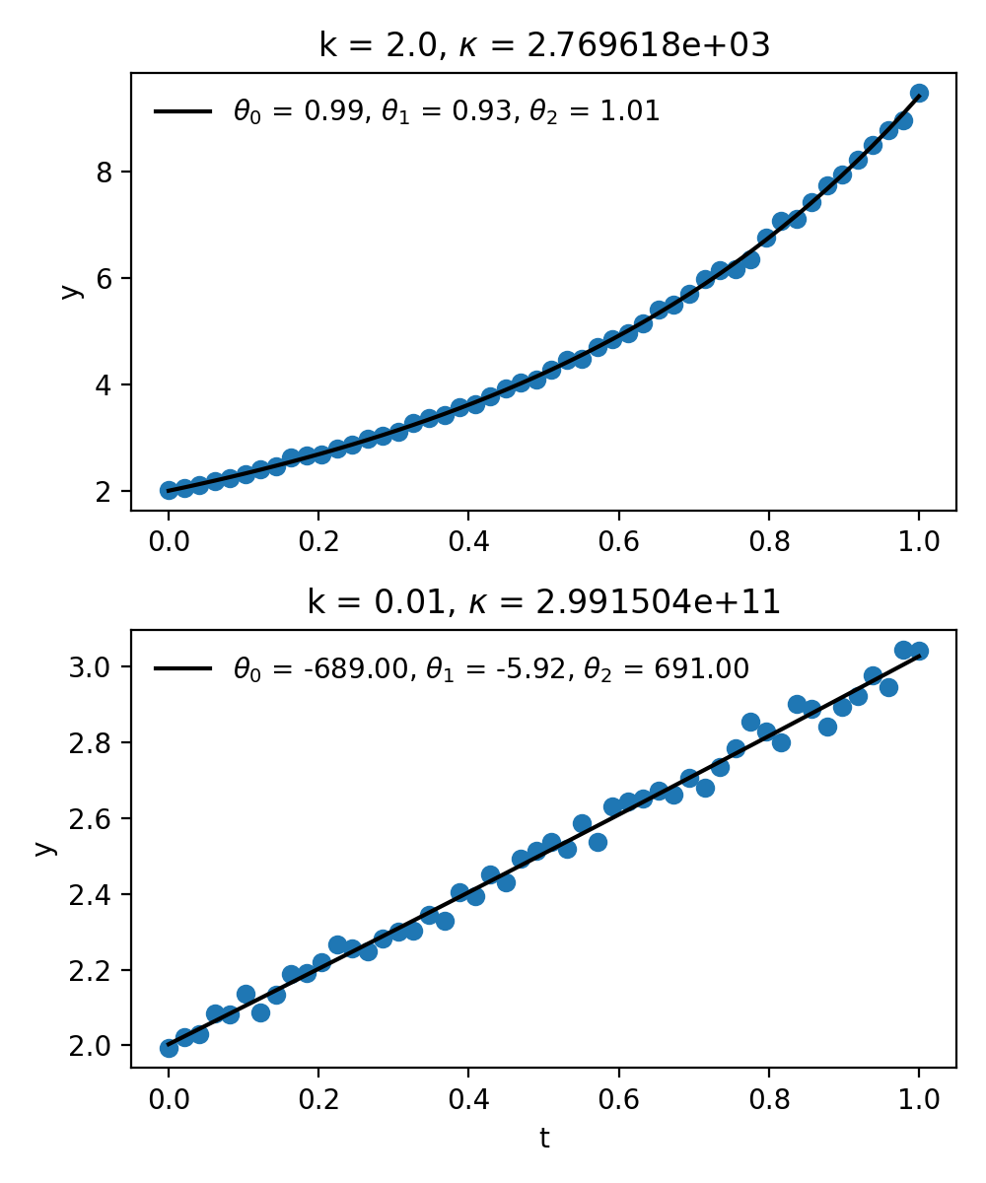
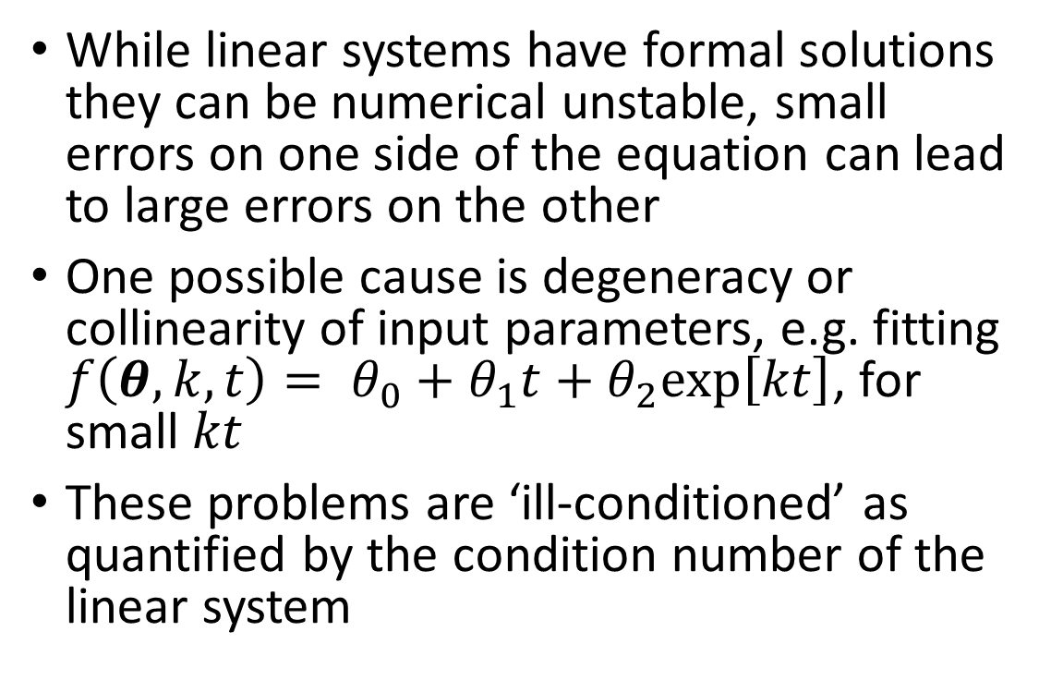
Ill-conditioned or ill-posed problems
While linear systems have formal solutions they can be numerical unstable, small errors on one side of the equation can lead to large errors on the other
One possible cause is degeneracy or collinearity of input parameters, e.g. fitting $f\left(θ,k,t\right)= θ_{0}+θ_{1}t+θ_{2}\text{exp}\left[kt\right]$, for small $kt$
These problems are ‘ill-conditioned’ as quantified by the condition number of the linear system

Slide 12
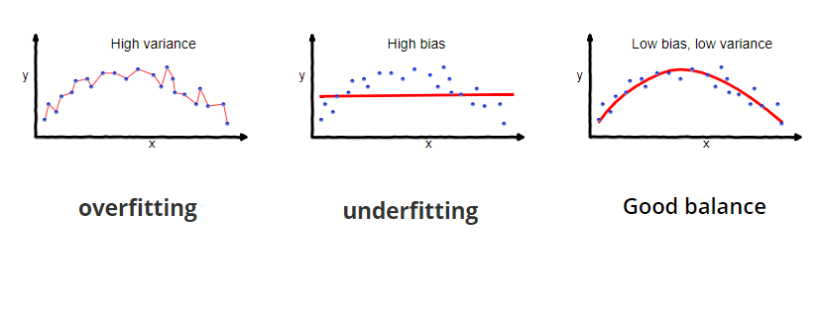
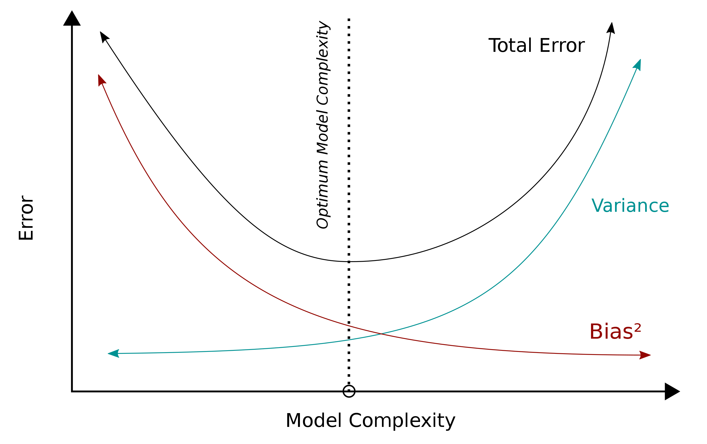
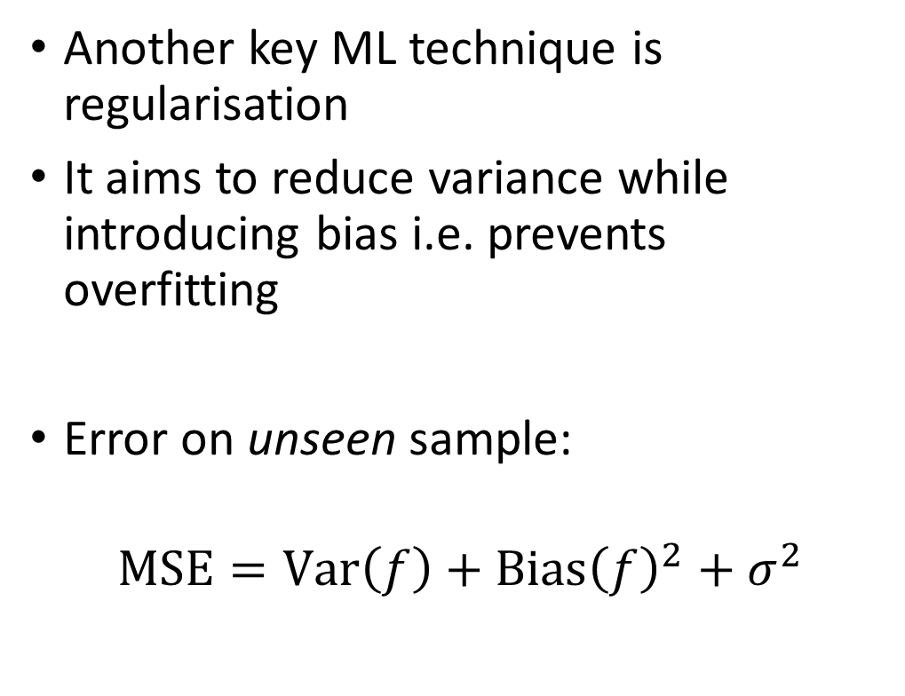
Regularisation – Bias-variance tradeoff
Another key ML technique is regularisation
It aims to reduce variance while introducing bias i.e. prevents overfitting
Error on unseen sample:
$$\text{MSE}=\text{Var}\left(f\right)+{\text{Bias}\left(f\right)}^{2}+σ^{2}$$

Slide 13
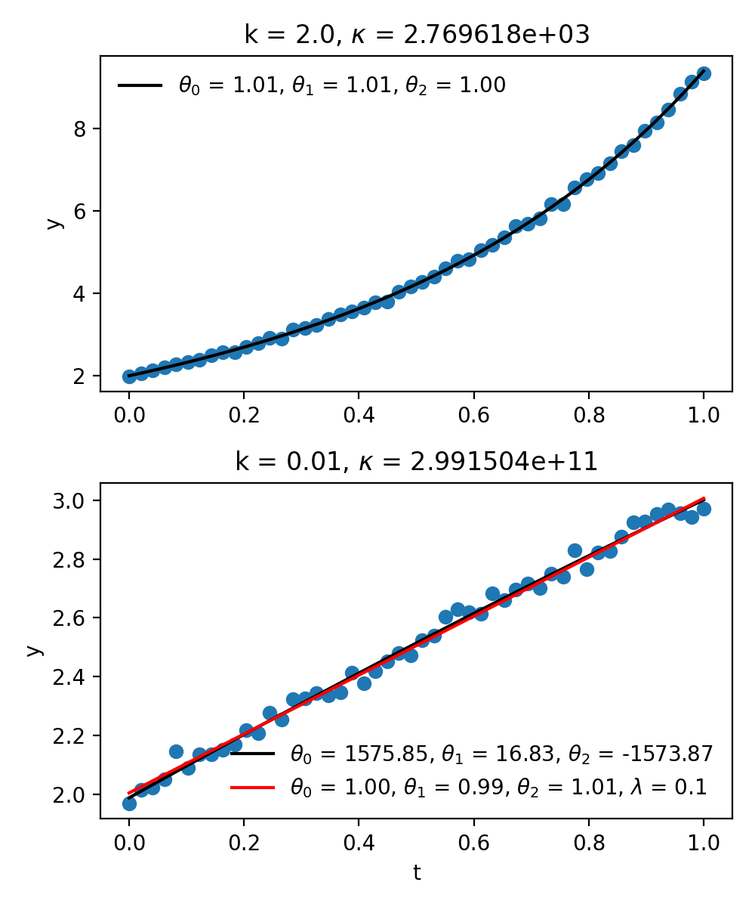
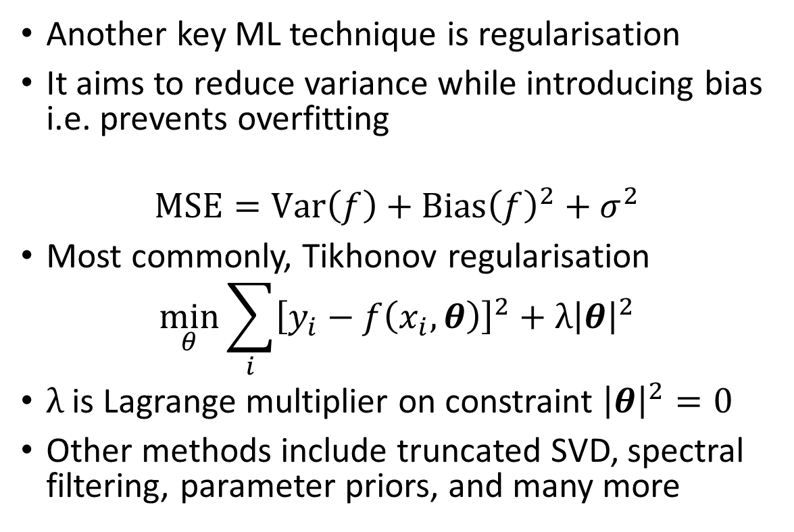
Regularisation
Another key ML technique is regularisation
It aims to reduce variance while introducing bias i.e. prevents overfitting
$$\text{MSE}=\text{Var}\left(f\right)+{\text{Bias}\left(f\right)}^{2}+σ^{2}$$
Most commonly, Tikhonov regularisation
$$\min_{θ}{\sum_{i}{{\left[y_{i}−f\left(x_{i},θ\right)\right]}^{2}}}+λ{\left|θ\right|}^{2}$$
$λ$ is Lagrange multiplier on constraint ${\left|θ\right|}^{2}=0$
Other methods include truncated SVD, spectral filtering, parameter priors, and many more

Slide 14
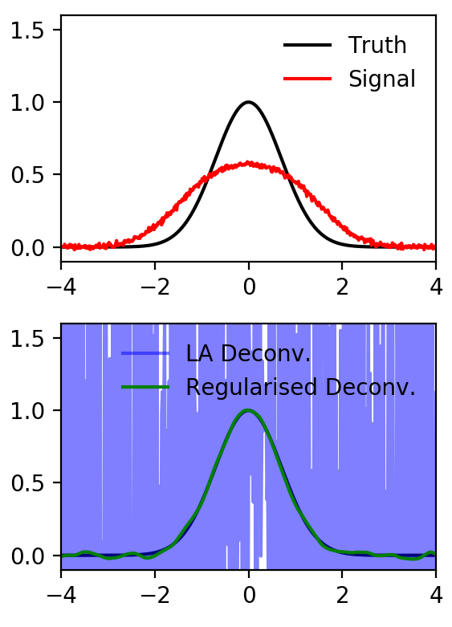
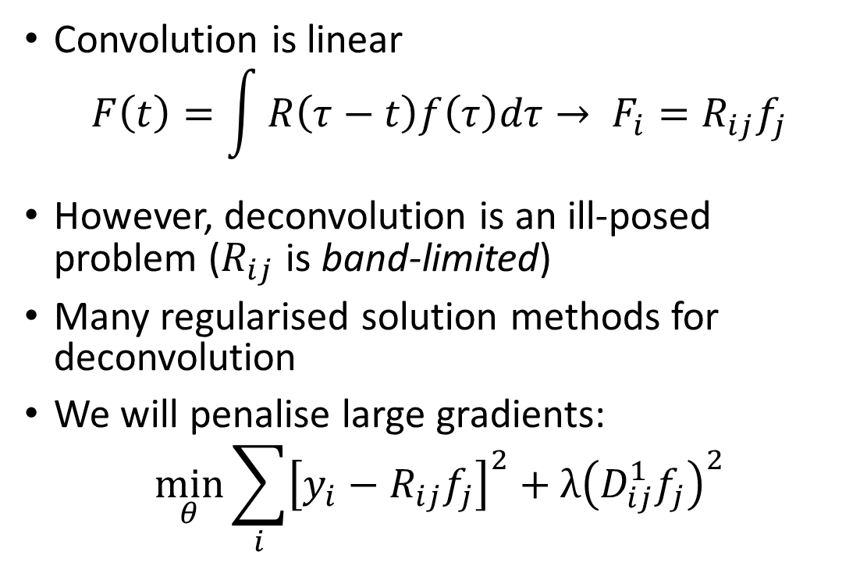
Deconvolution and Regularisation
Convolution is linear
$$F\left(t\right)=\int{R\left(τ−t\right)f\left(τ\right)dτ}→ F_{i}=R_{ij}f_{j}$$
However, deconvolution is an ill-posed problem ($R_{ij}$ is band-limited)
Many regularised solution methods for deconvolution
We will penalise large gradients:
$$\min_{θ}{\sum_{i}{{\left[y_{i}−R_{ij}f_{j}\right]}^{2}}}+λ{\left(D_{ij}^{1}f_{j}\right)}^{2}$$
First order finite difference

Slide 15
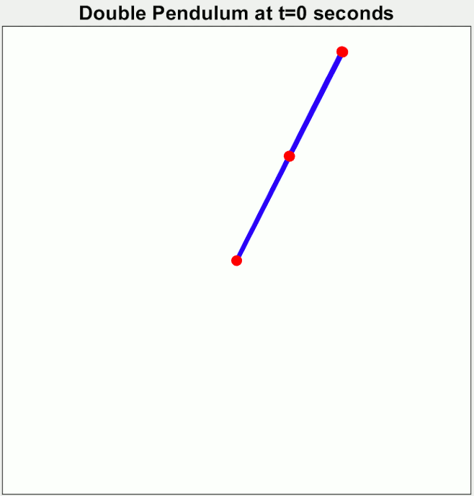
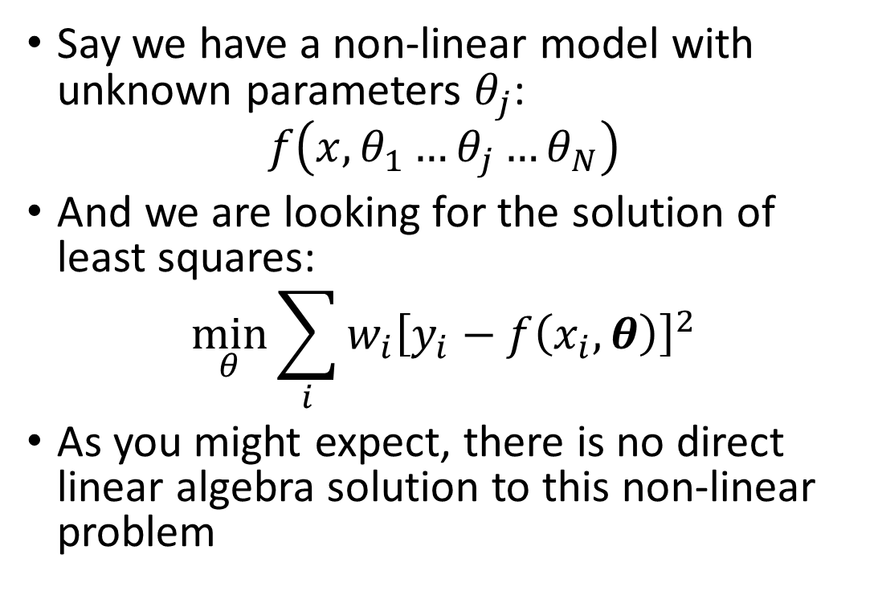
Non-Linear Least Squares
Say we have a non-linear model with unknown parameters $θ_{j}$:
$$f\left(x,θ_{1}…θ_{j}…θ_{N}\right)$$
And we are looking for the solution of least squares:
$$\min_{θ}{\sum_{i}{{w_{i}\left[y_{i}−f\left(x_{i},θ\right)\right]}^{2}}}$$
As you might expect, there is no direct linear algebra solution to this non-linear problem

Slide 16
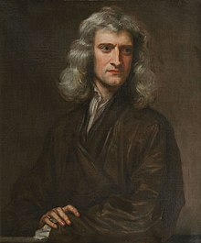
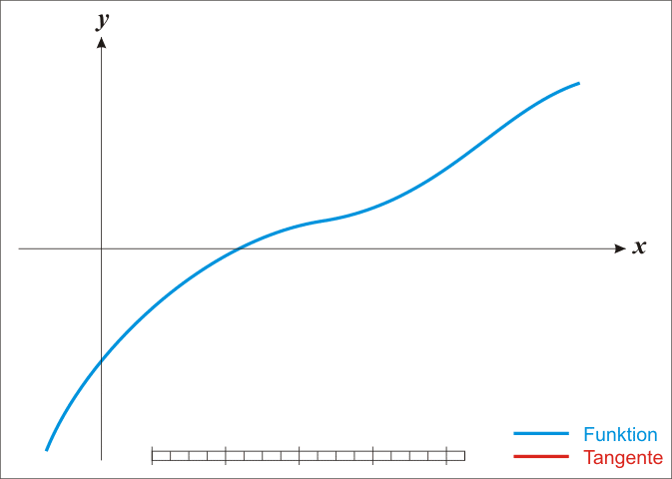
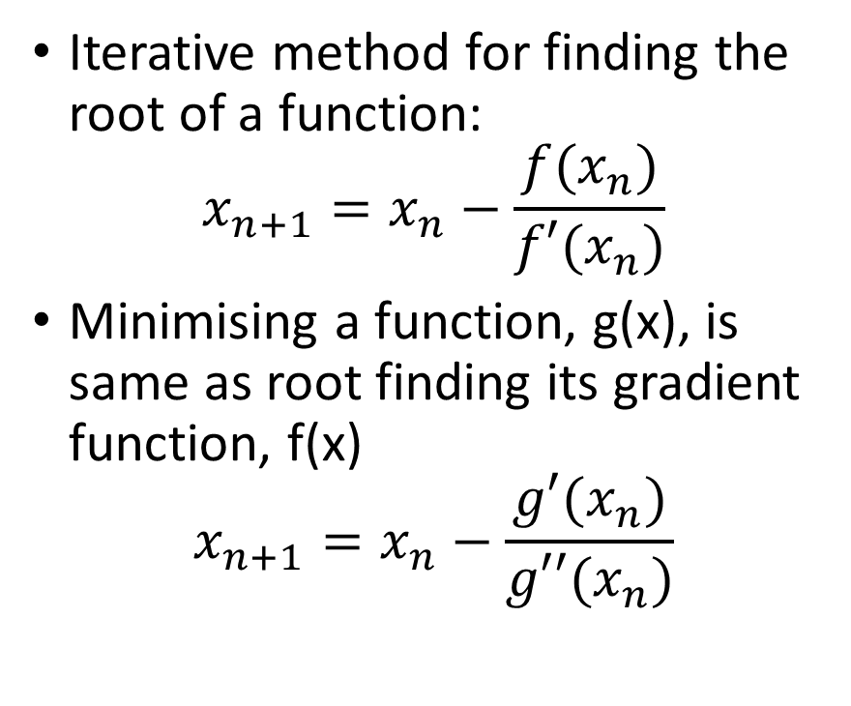
Reminder: Newton-Raphson Method
Iterative method for finding the root of a function:
$$x_{n+1}=x_{n}−\frac{f(x_{n})}{f′(x_{n})}$$
Minimising a function, g(x), is same as root finding its gradient function, f(x)
$$x_{n+1}=x_{n}−\frac{g′(x_{n})}{g′′(x_{n})}$$

Slide 17
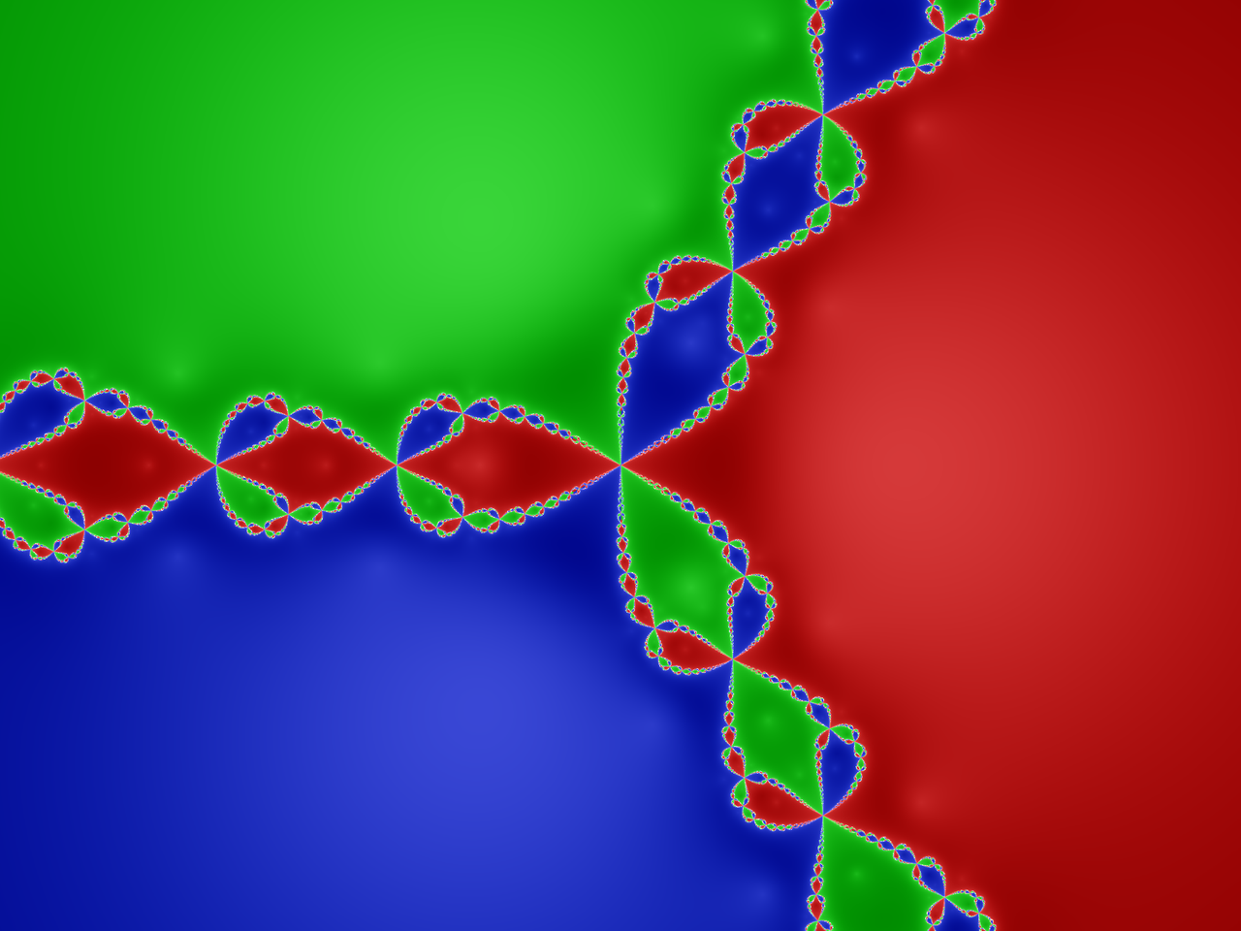
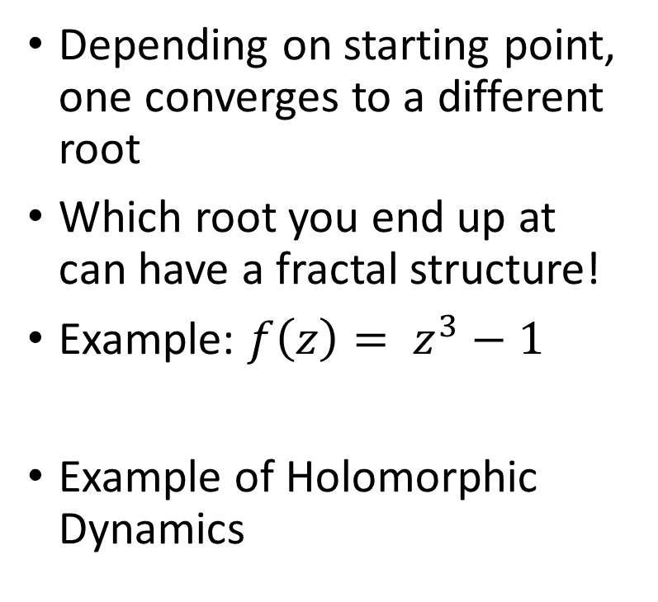
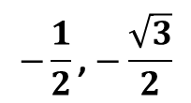
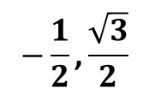
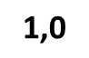
Fun aside: Newton’s Fractal
Depending on starting point, one converges to a different root
Which root you end up at can have a fractal structure!
Example: $f\left(z\right)= z^{3}−1$
Example of Holomorphic Dynamics
$$−\frac{1}{2}\text{,}\frac{\sqrt{3}}{2}$$
$$\text{1,0}$$
$$−\frac{1}{2}\text{,}−\frac{\sqrt{3}}{2}$$

Slide 18
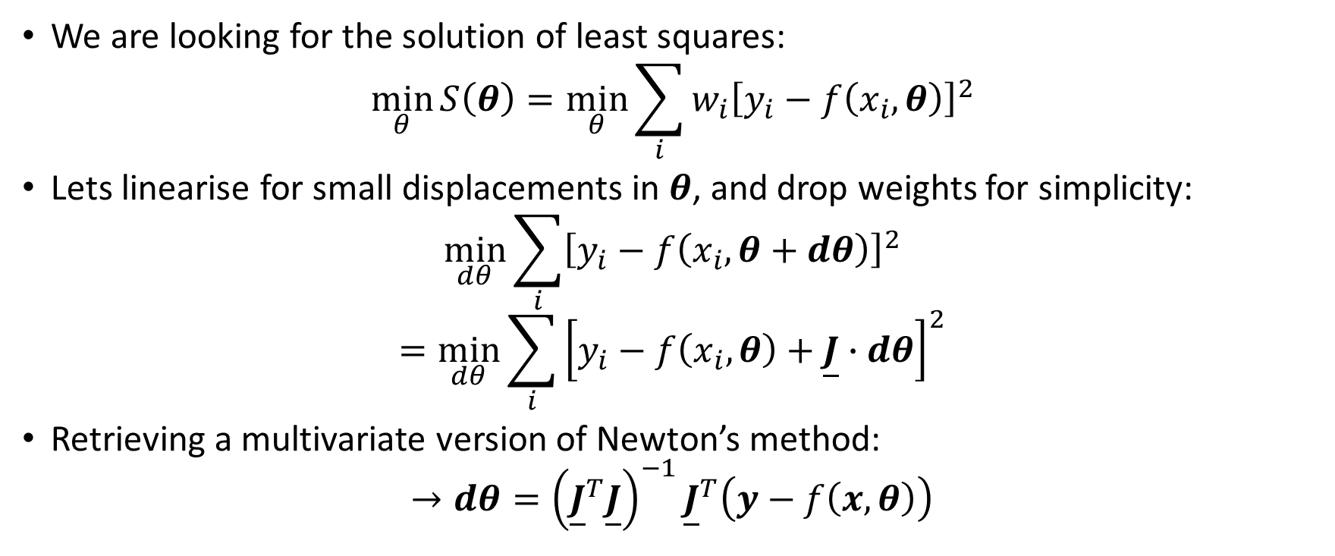
Non-Linear Least Squares
We are looking for the solution of least squares:
$$\min_{θ}{S\left(θ\right)=\min_{θ}\sum_{i}{{w_{i}\left[y_{i}−f\left(x_{i},θ\right)\right]}^{2}}}$$
Lets linearise for small displacements in $θ$, and drop weights for simplicity:
$$\min_{dθ}{\sum_{i}{{\left[y_{i}−f\left(x_{i},θ+dθ\right)\right]}^{2}}}$$
$$=\min_{dθ}{\sum_{i}{{\left[y_{i}−f\left(x_{i},θ\right)+\underline{J}∙dθ\right]}^{2}}}$$
Retrieving a multivariate version of Newton’s method:
$$→dθ={\left({\underline{J}}^{T}\underline{J}\right)}^{−1}{\underline{J}}^{T}\left(y−f\left(x,θ\right)\right)$$
N.B. we have approximated the Hessian as $2{\underline{J}}^{T}\underline{J}$, ignoring all 2nd derivatives, so we can get stuck in saddlepoints!

Slide 19
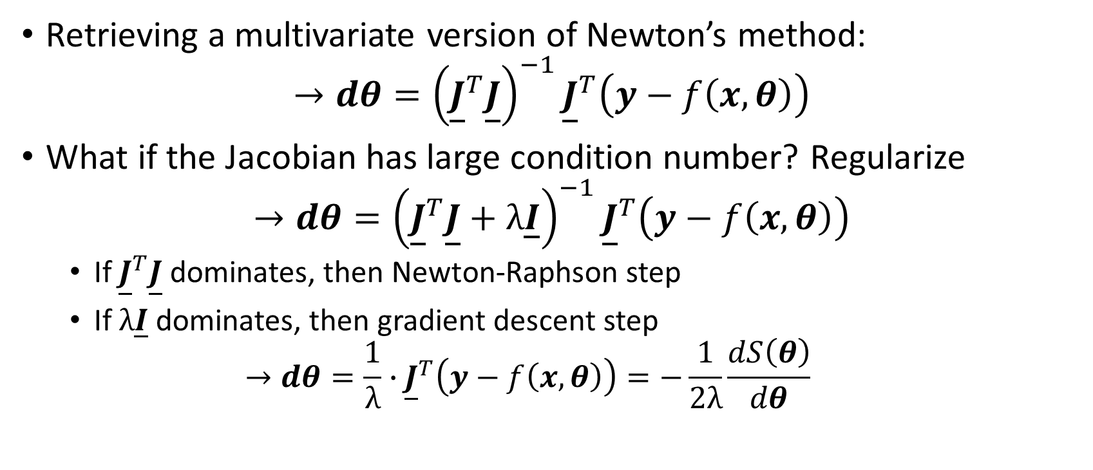
Non-Linear Least Squares
Retrieving a multivariate version of Newton’s method:
$$→dθ={\left({\underline{J}}^{T}\underline{J}\right)}^{−1}{\underline{J}}^{T}\left(y−f\left(x,θ\right)\right)$$
What if the Jacobian has large condition number? Regularize
$$→dθ={\left({\underline{J}}^{T}\underline{J}+λ\underline{I}\right)}^{−1}{\underline{J}}^{T}\left(y−f\left(x,θ\right)\right)$$
If ${\underline{J}}^{T}\underline{J}$ dominates, then Newton-Raphson step
If $λ\underline{I}$ dominates, then gradient descent step
$$→dθ=\frac{1}{λ}∙{\underline{J}}^{T}\left(y−f\left(x,θ\right)\right)=−\frac{1}{2λ}\frac{dS\left(θ\right)}{dθ}$$
N.B. Levenberg-Marquardt algorithm uses the above but adaptively changes $λ$, this is default algorithm in scipy.optimize.curve_fit

Slide 20
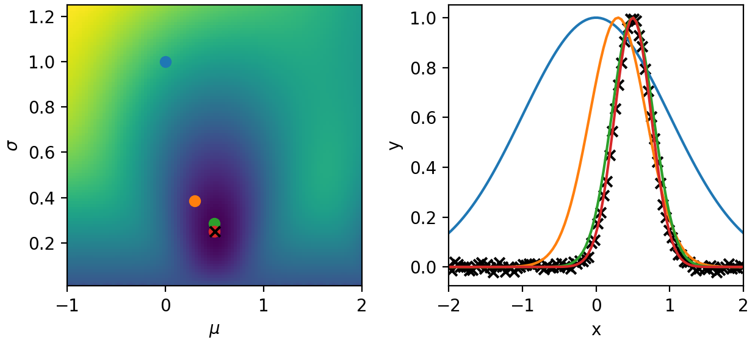

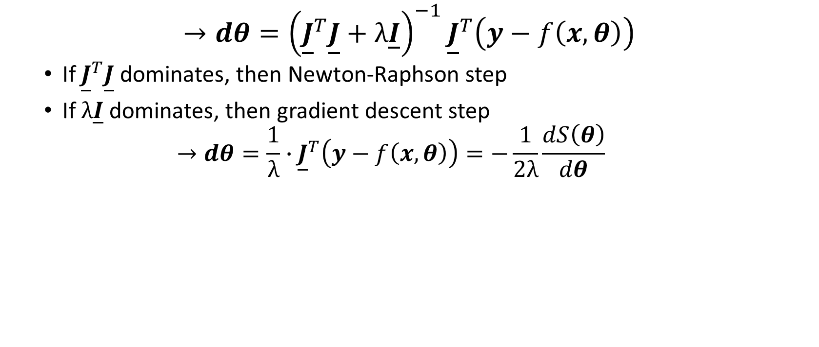
Non-Linear Least Squares
$$→dθ={\left({\underline{J}}^{T}\underline{J}+λ\underline{I}\right)}^{−1}{\underline{J}}^{T}\left(y−f\left(x,θ\right)\right)$$
If ${\underline{J}}^{T}\underline{J}$ dominates, then Newton-Raphson step
If $λ\underline{I}$ dominates, then gradient descent step
$$→dθ=\frac{1}{λ}∙{\underline{J}}^{T}\left(y−f\left(x,θ\right)\right)=−\frac{1}{2λ}\frac{dS\left(θ\right)}{dθ}$$
Newton-Raphson
Gradient Descent

Slide 21
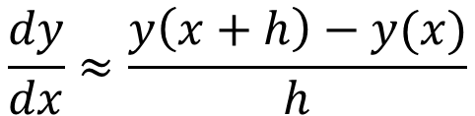
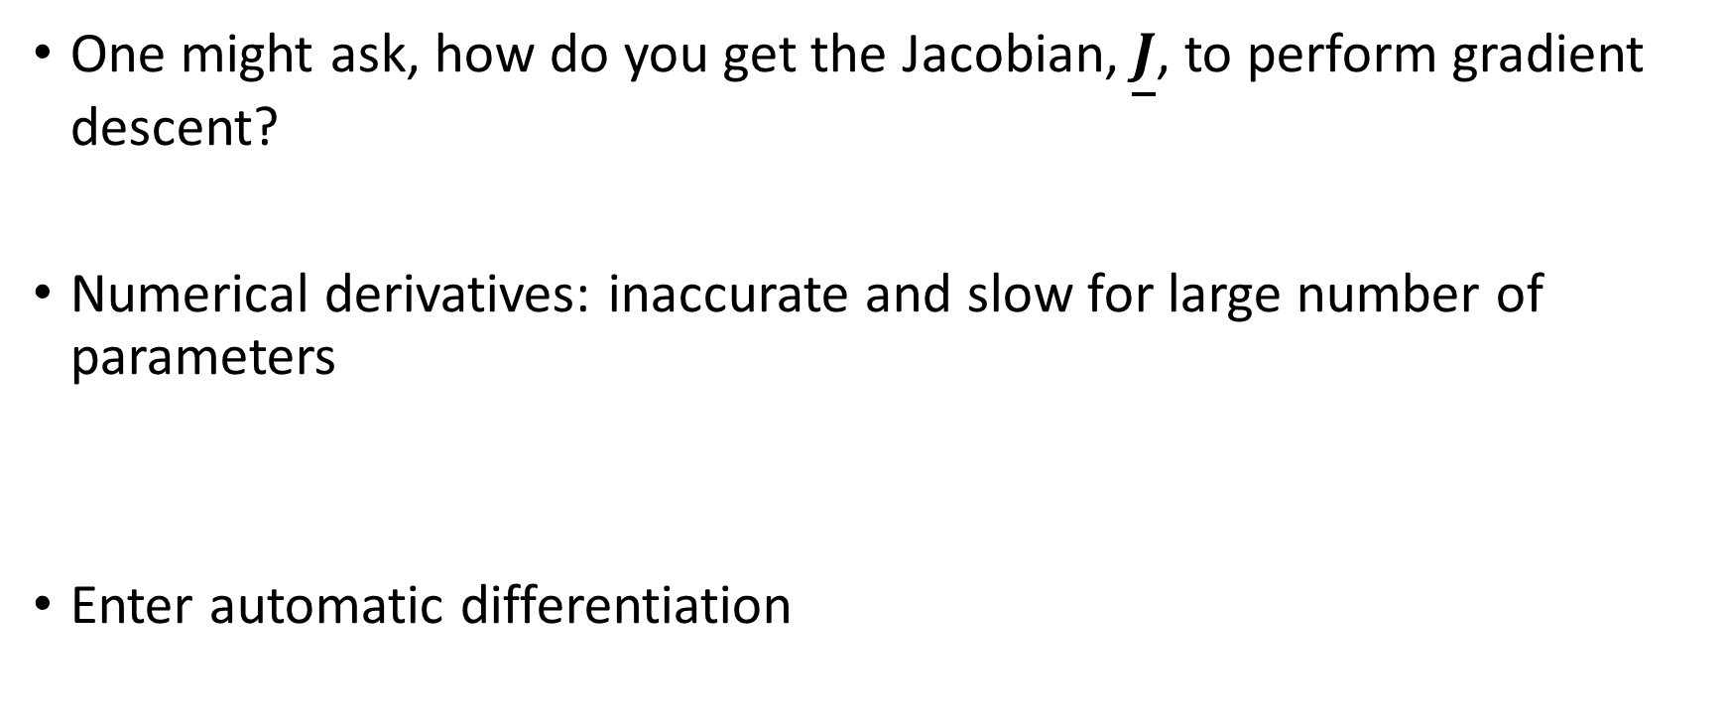
Differentiable Programming
One might ask, how do you get the Jacobian, $\underline{J}$, to perform gradient descent?
Numerical derivatives: inaccurate and slow for large number of parameters
Enter automatic differentiation
$$\frac{dy}{dx}≈\frac{y\left(x+h\right)−y(x)}{h}$$

Slide 22
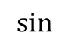


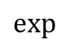

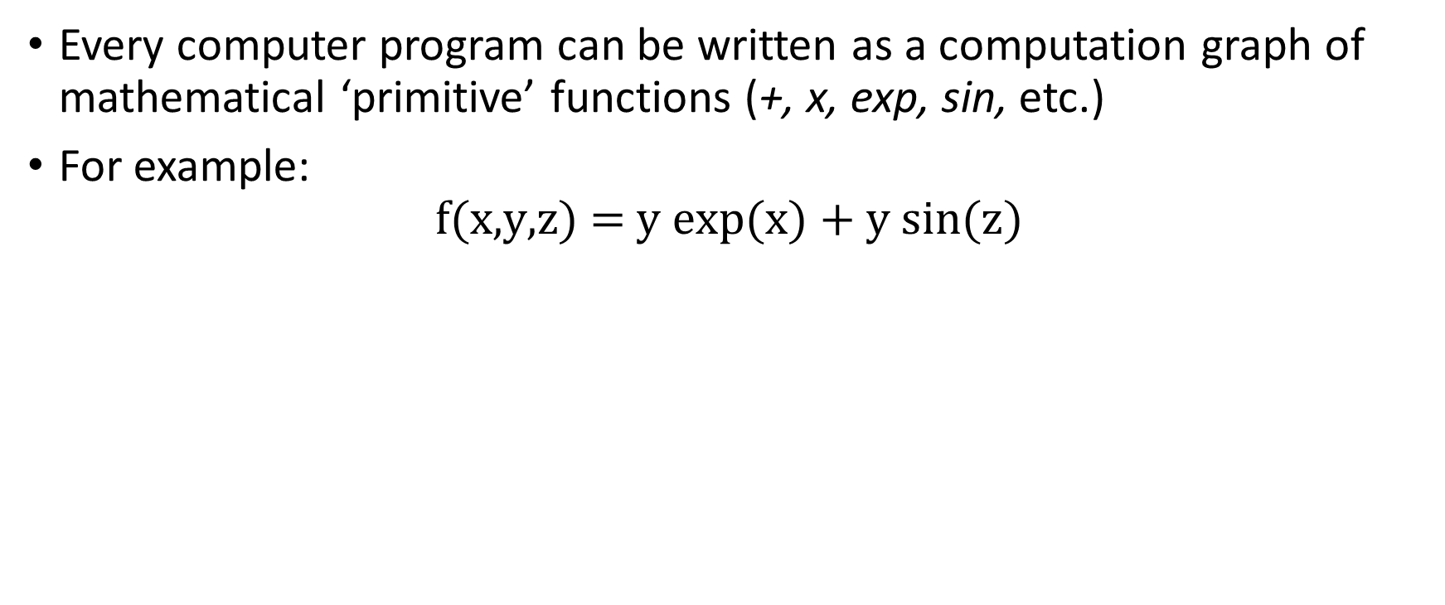
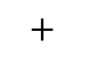








Automatic Differentiation Intro
Every computer program can be written as a computation graph of mathematical ‘primitive’ functions (+, x, exp, sin, etc.)
For example:
$$\text{f}\text{(}\text{x}\text{,}\text{y}\text{,}\text{z}\text{) = }\text{y} \text{exp}\text{(}\text{x}\text{) + }\text{y} \text{sin}\text{(}\text{z}\text{)}$$
x
$$α_{1}$$
$$\text{exp}$$
$$α_{4}$$
$$∗$$
$$α_{6}$$
$$+$$
y
$$α_{2}$$
$$α_{8}$$
$$f$$
$$∗$$
$$α_{7}$$
z
$$α_{3}$$
$$\text{sin}$$
$$α_{5}$$

Slide 23


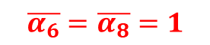

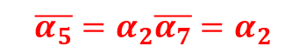
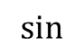

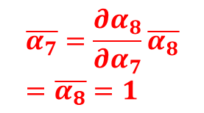

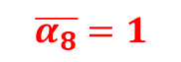
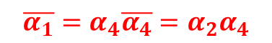
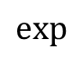

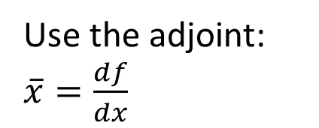

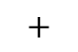

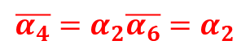



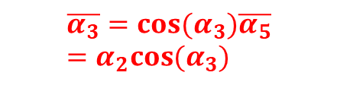
Automatic Differentiation Intro
In our example:
Use the adjoint: $\overline{x}=\frac{df}{dx}$
$$\overline{α_{1}}=α_{4}\overline{α_{4}}=α_{2}α_{4}$$
$$\overline{α_{4}}=α_{2}\overline{α_{6}}=α_{2}$$
x
$$α_{1}$$
$$\text{exp}$$
$$α_{4}$$
$$\overline{α_{6}}=\overline{α_{8}}=1$$
$$∗$$
$$\overline{α_{2}}=α_{4}\overline{α_{6}}+α_{5}\overline{α_{7}}=α_{4}+α_{5}$$
$$α_{6}$$
$$+$$
y
$$α_{2}$$
$$α_{8}$$
$$f$$
$$∗$$
$$α_{7}$$
$$\overline{α_{8}}=1$$
z
$$α_{3}$$
$$\text{sin}$$
$$α_{5}$$
$$\overline{α_{7}}=\frac{∂α_{8}}{∂α_{7}}\overline{α_{8}}=\overline{α_{8}}=1$$
$$\overline{α_{3}}=cos(α_{3})\overline{α_{5}}=α_{2}cos(α_{3})$$
$$\overline{α_{5}}=α_{2}\overline{α_{7}}=α_{2}$$
A single ‘back-propagation’ gives all gradients!

Slide 24
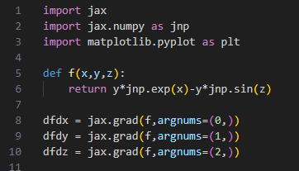















Automatic Differentiation Intro
In JAX:
In our example:
$$\overline{α_{1}}=α_{4}\overline{α_{4}}=α_{2}α_{4}$$
$$\overline{α_{4}}=α_{2}\overline{α_{6}}=α_{2}$$
x
$$α_{1}$$
$$\text{exp}$$
$$α_{4}$$
$$\overline{α_{6}}=\overline{α_{8}}=1$$
$$∗$$
$$\overline{α_{2}}=α_{4}\overline{α_{6}}+α_{5}\overline{α_{7}}=α_{4}+α_{5}$$
$$α_{6}$$
$$+$$
y
$$α_{2}$$
$$α_{8}$$
$$f$$
$$∗$$
$$α_{7}$$
$$\overline{α_{8}}=1$$
z
$$α_{3}$$
$$\text{sin}$$
$$α_{5}$$
$$\overline{α_{7}}=\frac{∂α_{8}}{∂α_{7}}\overline{α_{8}}=\overline{α_{8}}=1$$
$$\overline{α_{3}}=cos(α_{3})\overline{α_{5}}=α_{2}cos(α_{3})$$
$$\overline{α_{5}}=α_{2}\overline{α_{7}}=α_{2}$$
A single ‘back-propagation’ gives all gradients!

Slide 25

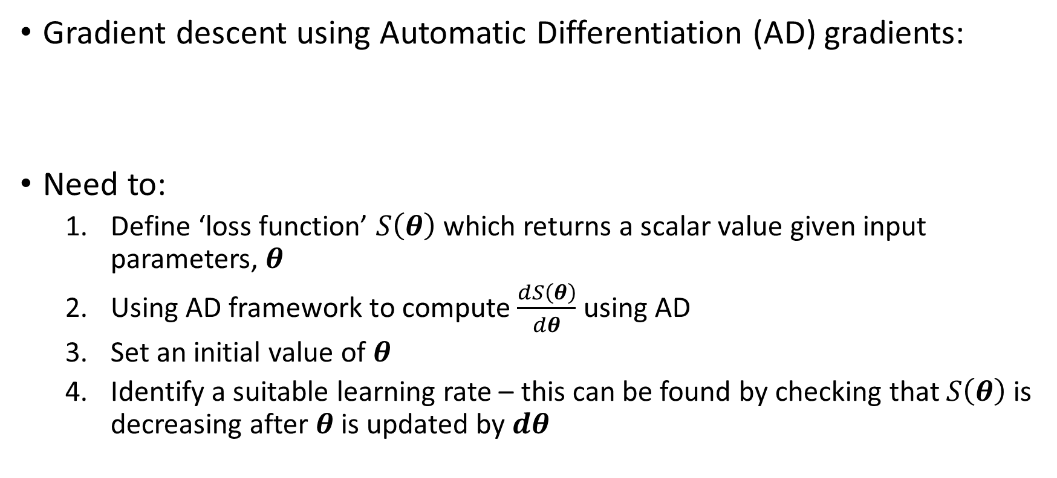
Automatic Differentiation Intro
Gradient descent using Automatic Differentiation (AD) gradients:
Need to:
Define ‘loss function’ $S\left(θ\right)$ which returns a scalar value given input parameters, $θ$
Using AD framework to compute $\frac{dS\left(θ\right)}{dθ}$ using AD
Set an initial value of $θ$
Identify a suitable learning rate – this can be found by checking that $S\left(θ\right)$ is decreasing after $θ$ is updated by $dθ$
$$dθ=\frac{1}{λ}∙{\underline{J}}^{T}\left(y−f\left(x,θ\right)\right)=−\frac{1}{2λ}\frac{dS\left(θ\right)}{dθ}$$
Other optimisers can use AD gradients, we shall cover them later

Slide 26
Using regression for inference
Finding the ‘best fit’ is an optimisation problem
In inference, we need additional information – the uncertainties

Slide 27




Bayes Theorem and Likelihoods
Bayes’ Theorem states:
Canonical example, medical testing:
Observations always have uncertainty, therefore Bayes rule must be used in parameter estimation
$$P\left(A | B\right)= \frac{P\left(B | A\right)P(A)}{P(B)}=\frac{\text{Likelihood} \text{x} \text{Prior}}{\text{Evidence}}$$
$$P\left(\text{ill} | +\right)= \frac{P\left(+ | \text{ill}\right)P(\text{ill})}{P(+)}=\frac{\text{Sensitivity} \text{x} \text{Prevalence}}{\text{True} \text{Positive}+\text{False} \text{Positive}}$$

Slide 28

Bayesian Inference
We wish to find the most likely physical parameters which describe the data:
P(model parameters given data): $P\left(θ | y\right)∝P\left(y | θ\right)P(θ)$
Define a likelihood that given the model, $f(θ,x)$, you would observe the data, say Gaussian errors:
$$P\left(θ | y\right)∝P(θ)\prod_{i}{\text{exp}\left(−\frac{{\left(y_{i}−f\left(x_{i},θ\right)\right)}^{2}}{2σ_{i}^{2}}\right)}$$
Take the logarithm to separate likelihood and priors
$$∝ \text{log}\text{(}P\left(y | θ\right)\text{) + }\text{log}\text{(}P(θ))=−\sum_{i}{{w_{i}\left[y_{i}−f\left(x_{i},θ\right)\right]}^{2}}+R(θ)$$
Least squares
Regularisation
Maximal posterior = Minimal least squares

Slide 29


Bayesian Inference – Laplace’s Method
Pierre-Simon Laplace
If we expand the log posterior about its optimum:
$$−\log\left(P\left(θ | y\right)\right)=F\left(θ\right)≈F\left(θ^{∗}\right)+J_{F}(θ) \left(θ−θ^{∗}\right)+\frac{1}{2}H_{F}(θ) {\left(θ−θ^{∗}\right)}^{2}$$
We see the posterior is locally a multi-variate normal:
$$P\left(θ | y\right)\sim exp⁡\left[−\frac{1}{2}H_{F}(θ) {\left(θ−θ^{∗}\right)}^{2}\right]$$
The Hessian gives us the covariance matrix – this is what scipy’s curve_fit is doing
0

Slide 30



Example in PythonJAX – Differentiable Programming
Following our non-linear least squares example, lets fit a Gaussian to data with uncertainties estimated using Laplace’s method
$$\underline{Σ}={\underline{H}}^{−1}$$

Slide 31



Bayesian Inference: Markov Chain Monte Carlo (MCMC)
We wish to find the posterior distribution of some parameters but we can only evaluate a function proportional to it (Likelihood x Prior)
70%
Markov chain:
A sequence of possible events where the next state only depends on the current state
Monte Carlo:
A class of numerical algorithm which involves repeated random sampling
70%
30%
10%
30%
90%
MCMC: Construct a Markov chain which has an equilibrium distribution of the posterior

Slide 32





Metropolis-Hastings* Algorithm
$P(x)$ is the probability distribution function we want to sample, $f\left(x\right)∝P(x)$:
Starting at $x_{i}$, randomly select a point $x^{∗}$ using jumping function $J(x^{∗}|x_{i})$
Compute the acceptance ratio, $α=f(x^{∗})/f(x_{i})$ and a random number $u∈[0,1]$
If $u ≤ α$, accept $x^{∗}→x_{i+1}$
Else, reject and $x_{i}→x_{i+1}$
* Arguably, the Rosenbluth algorithm

Slide 33
BREAK

Slide 34


Non-Parametric Regressors
In the absence of a parametric model, one might want a generic fitting model
Increasing in various levels of complexity:
Nearest-neighbour interpolation
Splines
Gaussian processes
Fitting function modifies as you introduce more data? That’s a nonparametric regressor
Spline fits are linear least squares:
$$f\left(x\right)= \sum_{i}{a_{i}B(x_{i},x)}$$
Given data, construct $B_{ij}$ at points $x_{j}$
Optimal amplitudes then:
$$\hat{a}={\left({\underline{B}}^{T} \underline{B}\right)}^{−1}{\underline{B}}^{T} y$$

Slide 35


Conditioning multivariate normals
We wish the predict the random variable $Y_{0}$ given data $Y_{n}$, these will be correlated
Assume joint distribution of prediction + data is multivariate normal:
$$\left(\begin{matrix}Y_{0} \\ Y_{n}\end{matrix}\right)\sim N_{1+n}\left[\begin{matrix}μ_{0} \\ μ_{n}\end{matrix},σ^{2}\left(\begin{matrix}R_{11} & R_{12} \\ R_{21} & R_{22}\end{matrix}\right)\right]$$
Conditional distribution of known data has mean and covariance matrix given by:
$$E\left(Y_{0}\right)=μ_{0}+R_{12}R_{22}^{−1}(Y_{n}−μ_{n})$$
$$Var\left(Y_{0}\right)=σ^{2}(R_{11}−R_{12}R_{22}^{−1}R_{21})$$
For more detail see: The Design and Analysis of Computer Experiments by Santner, Williams and Notz

Slide 36





Gaussian Processes
$$\underline{Σ}=σ^{2}\left[\begin{matrix}\begin{matrix}R(x_{0}−x_{0}) & R(x_{1}−x_{0}) \\ R(x_{0}−x_{1}) & R(x_{1}−x_{1})\end{matrix} & \begin{matrix}⋯ & R(x_{N}−x_{0}) \\ ⋯ & R(x_{N}−x_{1})\end{matrix} \\ \begin{matrix}⋮ & ⋮ \\ R(x_{0}−x_{N}) & R(x_{1}−x_{N})\end{matrix} & \begin{matrix}⋱ & ⋮ \\ ⋯ & R(x_{N}−x_{N})\end{matrix}\end{matrix}\right]$$
Gaussian processes use the conditional distribution to predict unobserved points
Mean function (usually 0) is linear fitting function, $μ\left(x\right)=\sum_{i}{θ_{i}f_{i}(x)}$
Correlation matrix defined by ‘kernel’ function $R\left(d\right)$
$$Y\left(x\right)= μ\left(x\right)+Z(μ=0,R\left(d\right))$$
Correlation function quantifies how correlated points in space are
How do you pick kernel free parameters…
$$E\left(Y_{0}\right)=R_{12}R_{22}^{−1}Y_{n}$$
$$R\left(d,l\right)=\text{exp}\left[−\frac{1}{2}{\left(\frac{d}{l}\right)}^{2}\right]$$

Slide 37


Gaussian Processes: Example
Kernel parameters found by maximal likelihood estimation given known data
Python libraries: Gpy, sklearn

Slide 38







Neural Networks
Neural networks are the canonical AI model
They are black-box functions with many, many learnable parameters, ChatGPT 175 billion
Many flavours, we will discuss the multi-layer perceptron (MLP)
Basic unit is the neuron:
Neuron properties: Parameters: weight $w$, bias $b$
Activation function: tanh, ReLU, etc.
Input: $x$
Output: $y$
$$x^{′}= wx+b$$
$$y$$

Slide 39






Multi-Layer Perceptron
Stack neurons into layers and fully-connect layers
Define loss function between predicted and real outputs e.g. mean-squared-error (MSE)
Update neuron parameters by gradient descent (or variations of it)
It is just regularised non-linear least squares again!
$$dθ=α∙{\underline{J}}^{T}\left(y−f\left(x,θ\right)\right)$$
Rosenblatt with the Mark 1 Perceptron
Various optimisers
Loss
$$θ_{2}$$
$$θ_{1}$$
Learning rate
Jacobian found by AD
Neural network

Slide 40


Loss terms for neural networks
The most common are ‘prediction metrics’ such as mean squared error
Regularisers on weights and biases, common example is ‘L2-norm’ which is the same as Tikhonov, $λ{\left|θ\right|}^{2}$
$λ$ is now hyper-parameter like learning rate, $α$
More exotic terms are being introduced, like physics informed neural networks
AD allows derivative terms to be added to the loss

Slide 41



Neural Networks: Example
Learn relationship between Si IAW Thomson scattering features and physical parameters
$$θ=(n_{e},μ,T_{e},T_{i},Z,v_{fi},v_{fe})$$
$$y=({∆λ}_{m},{∆λ}_{h}−{∆λ}_{l},a_{λ})$$
Selection of the NN architecture can be human judgement or algorithmic
Tweaking of model parameters becomes tweaking of hyper-parameters
Data ‘featurisation’ is often key in producing a good model
1,411 trainable parameters

Slide 42






Neural Networks: Example
Learn relationship between Si IAW Thomson scattering features and physical parameters
$$θ=(n_{e},μ,T_{e},T_{i},Z,v_{fi},v_{fe})$$
$$y=({∆λ}_{m},{∆λ}_{h}−{∆λ}_{l},a_{λ})$$
Deep learning libraries: keras/tensorflow, sklearn, pytorch
$${∆λ}_{m}$$
$${∆λ}_{h}−{∆λ}_{l}$$
$$a_{λ}$$
https://gb.coursera.org/learn/neural-networks-deep-learning

Slide 43




Examples in the field
Surrogate model of secondaries in MagLIF
Transfer learning in ICF experiments
NLTE opacity emulators

Slide 44
Method/topic | Resource (Youtube, book, python library, course, etc.)
Machine Learning | https://github.com/josephmisiti/awesome-machine-learning - Curated list of ML resources SciKit-Learn (sklearn), pycaret package gives examples Scipy.optimize “Pattern Recognition and Machine Learning” book
Bayesian Statistics | “Statistical Rethinking” Youtube lecture series and book
Markov Chain Monte Carlo | PyMC, emcee
Gaussian Processes | GPy, GPyTorch, sklearn “Design and Analysis of Computer Experiments” book (WARNING: Mathsy)
Deep Learning | Andrew Ng’s Deep Learning specialisation on Coursera (Can be done for free within time window, otherwise monthly charge)
Neural Networks | Tensorflow, PyTorch, Keras
Differentiable Programming | JAX and associated libraries (diffrax, optax, …)
Optimisation | Convex Optimisation I and II, Stanford Engineering Everywhere
Software Engineering | Free O’Reilly access: https://www.oreilly.com/library-access/ - Python Cookbook Imperial’s ‘Essential Software Engineering for Researchers’ course (1 credit)

Slide 45
Technique | Pros | Cons
Traditional optimisation (e.g. least-squares with L-M) | Widely used and easy to start Low number of hyperparameters Familiar techniques | Cannot handle noisy data Often require known Jacobian for best performance Uncertainties use Laplace’s method Results depend on starting location Scales poorly Can require regularisation
Gradient free optimisation (e.g. Bayesian optimisation) | Finds global minimum No need for gradient information Can handle noisy data | Scales very poorly Choice of kernel (BO) Spend time exploring domain
Differentiable programming | Gradient information for any program Scales well Allows gradients to appear in loss function | Must write code in differentiable form – harder to debug
Splines, etc. | Flexible functions with local extent Data driven predictor | Often want model parameters not predictor function
Markov Chain Monte Carlo | Explore full posterior distribution Proper Bayesian treatment Does not require gradients (apart from HMCMC) | Large number of function evaluations needed
Gaussian processes | Like splines but with uncertainties | Scales poorly
Neural networks | Universal function approximators Scales very well Architectures adapted to problems e.g graphs for molecules | Requires large data set Large number of hyperparameters Model training can be expensive

Slide 46
Machine Learning in Plasma Group Research
Four examples of Plasma Group publications using ML:
“Using Differentiable Programming to Learn Closure Relations: An Example in Radiation Transport”
“Efficacy of inertial confinement fusion experiments in light ion fusion cross section measurement at nucleosynthesis relevant energies”
“Automation and control of laser wakefield accelerators using Bayesian optimization”
“Laser Wakefield Accelerator modelling with Variational Neural Networks”
“Monte Carlo modelling of the linear Breit-Wheeler process within the Geant4 framework”
These cover Differentiable Programming, Markov Chain Monte Carlo, Gaussian Processes, Neural Networks and optimisation techniques

Slide 47










Learning Closure Relations using Differentiable Programming: An Example in Radiation Transport (Crilly et al Accepted at NeurIPS ML 4 Physical Sciences Workshop 2023)
Open-source code
Can back-propagate gradients through solutions to PDEs
Numerical solutions to PDEs look like pre-trained recurrent graph neural networks
Allows closures to be learned from analytic test problems
Initial conditions
$$y_{0}$$
$$y_{1}$$
$$y_{2}$$
…
$$y_{N}$$
$$A_{0}$$
$$A_{1}$$
$$A_{2}$$
…
$$\text{ℒ}$$
Model parameters

Slide 48

Efficacy of inertial confinement fusion experiments in light ion fusion cross section measurement at nucleosynthesis relevant energies (Crilly et al Frontiers in Physics 2022)
This research looked to answer the question, given experimental uncertainties and model assumptions, how well can we constrain fusion cross sections using ICF experiments:
Produce synthetic data using full model
Including typical experimental uncertainties, fit synthetic data using reduced model
Explore the posterior distribution using MCMC
Demonstrate degeneracies and biases in reduced models

Slide 49

Automation and control of laser wakefield accelerators using Bayesian optimization (Shalloo et al Nat. Comms 2020)
Uses Gaussian Process Regression to optimize some property of a laser wakefield accelerator
Experimental measurements are made at initial positions
GPR model updated with the measurements to form a posterior distribution.
An acquisition function is computed and used to select the next measurement location.
Steps 3–4 are repeated until the convergence criteria are met.
Acquisition function chosen to balance finding the optimum and exploring the function
4 laser parameters and 2 plasma parameters controlled to optimize the brightness of generated X-rays

Slide 50



Laser Wakefield Accelerator modelling with Variational Neural Networks (Streeter et al HEDP 2023)
LWFA spectra differ from shot-to-shot
In experiments that use the beam we would like to know the spectrum on each shot
But if the beam is used, can we use other diagnostics to work out what the beam was?
We trained a variational neural network based on three non-invasive diagnostics to see if this was feasible
Variational neural networks free parameters are random normal variables
E.g. Weight $w →(μ_{w},σ_{w})$
15 example predictions – compared to the actual measurement
Black: measured spectrum; Red: model prediction;
Blue: previous best estimate without using a NN

Slide 51

Monte Carlo modelling of the linear Breit-Wheeler process within the Geant4 framework R Watt https://arxiv.org/pdf/2302.04950.pdf
Calculation of number of e+ e- pairs produced when high energy gamma rays pass through laser produced x-ray field
Calculation involves a triple integral – computationally expensive
Common solution would be to use look up table, but this wasn’t suitable
Instead, we use full calculations to train a GPR model "on-the-fly".
If error in GPR function is too high for a point in parameter space do full calculation
If its already low enough use the GPR model
This produces a significant speed up in the calculation after initial "training" phase

Slide 52

Links
Code and slides
URL: https://github.com/aidancrilly/ML_Lecture_Demos

